Slide 1
Ted Thurn
Director, Government Affairs
Institute of Real Estate Management®

Slide 2
Rental Assistance & the Eviction Moratorium

Slide 3
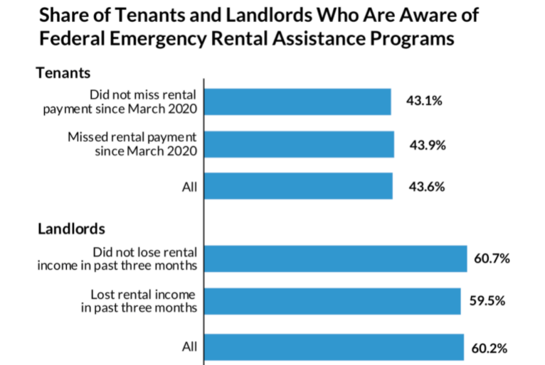
URBAN INSTITUTE

Slide 4
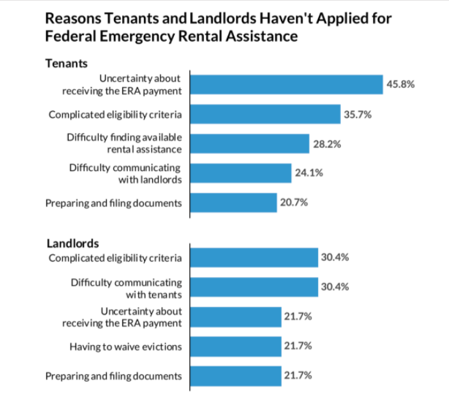
URBAN INSTITUTE

Slide 5

Q&A About Rental Assistance
How do I apply for emergency rental assistance?
What does emergency rental assistance cover?
Am I eligible for emergency rental assistance?
How can I show that I am eligible?
How are rental assistance payments made?
Special living situations

Slide 6
Consumer Financial Protection Bureau
The need for area-specific information on ERAP programs being communicated out – not directing to a federal page where someone then has to dig through several layers of redirects until they get to finally the application for their zip code.
Including information for landlords with communications to tenants, so a tenant who wants to participate in the program can provide something official and landlord-directed to their housing provider.
Changing the language around the program to appeal more broadly: many people associate the “Emergency Rental Assistance Program” with the eviction moratorium, and may mistakenly believe that when the latter ends, so does the former. There will also be people who are wary of interacting with a federal program.

Slide 7
Consumer Financial Protection Bureau
More direct outreach to smaller property owners: In general, Class A apartment complex owners are aware of the program; Class B and C are much less likely to know aid is available.
The CFPB needs to establish itself as an agency there to help landlords, and not just one looking out for tenants, which many housing providers believe. They need to adjust their language/outreach to landlords to make it explicit that these resources are there for them – carrot, not stick.
Try sending out communications on rental assistance that cross-over with populations who received pandemic unemployment, stimulus checks, and even PPP loans, as that indicates they were financially impacted by COVID and thus are more likely to be in need of rental assistance.

Slide 8

IREM Webinar -
Ending of the Federal Eviction Moratorium – What Property Managers Should Know & Best Practices to Follow

Slide 9
Ending of the Federal Eviction Moratorium
Deferred Payments – Are you working with your tenants to set up deferred payments?
Have you been waiving late fees for your tenants?
  Owner/Operator
  3rd Party Management
Have you provided rent abatement?
Emergency Rental Assistance – Have you been applying for rental assistance? How have you found the process to be in your state/city?

Slide 10
Ending of the Federal Eviction Moratorium
Can you begin the eviction process while tenant is waiting on their application?
Outreach to residents – how have you been communicating you’re your tenants since the moratorium was put in place to make sure they are paying rent, informing them of the moratorium?
  Email
  Phone call
  Social media/resident portal or Letter
  Community signage
  Personal outreach (door to door)
How have you been working with vendors slow down & staffing shortages?

